Slide 1
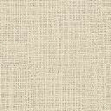
1
1
Patient
Patient
200
200
Condition A: Same patient stratification
Run
Run
Run
Run
gNMF
gNMF
m-gNMF
m-gNMF
1
1
Patient
Patient
200
200
Condition B: Different patient stratification

Slide 2
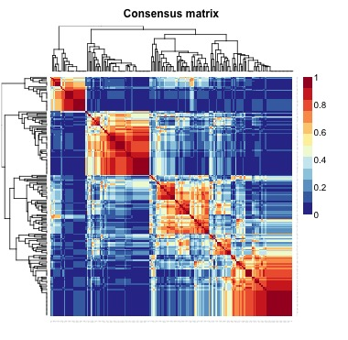
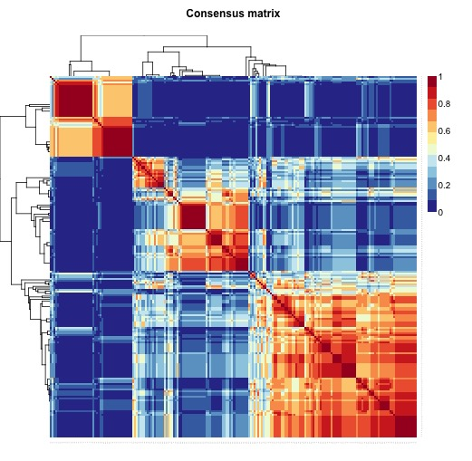
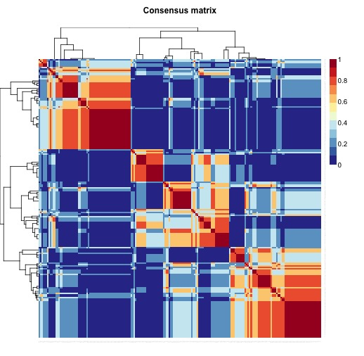
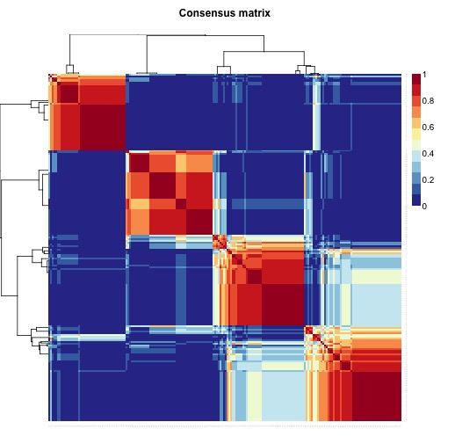
Input 1
Input 2
Input 1+1
Input 1+2

Slide 3
Figure 1
A
B

Slide 4
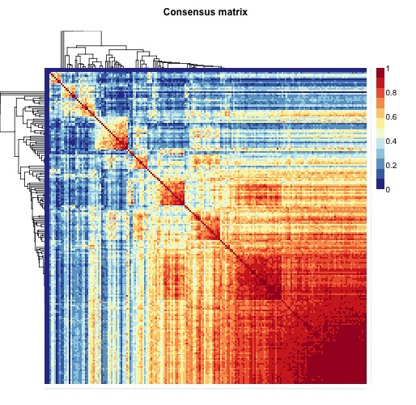
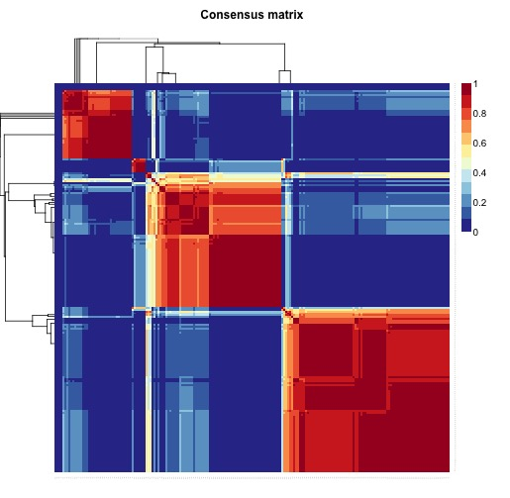
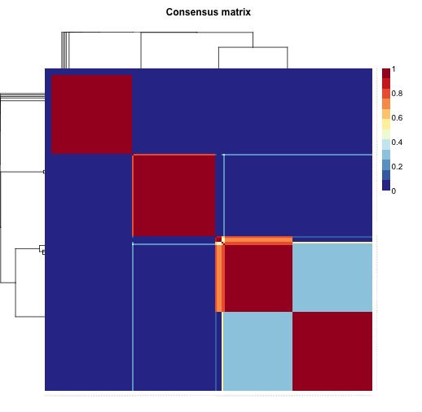
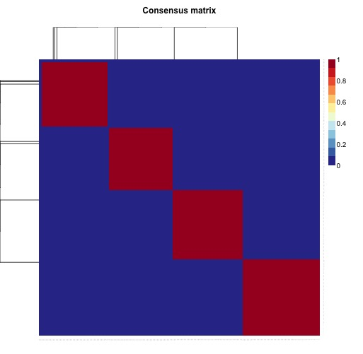
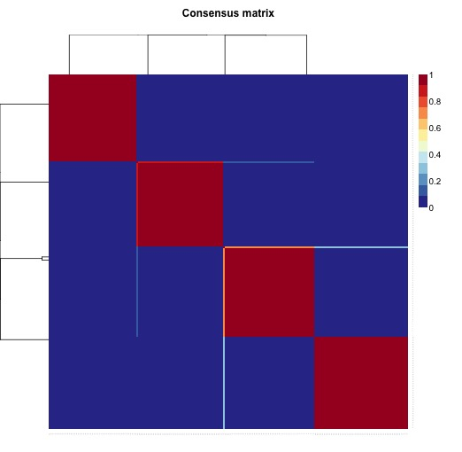
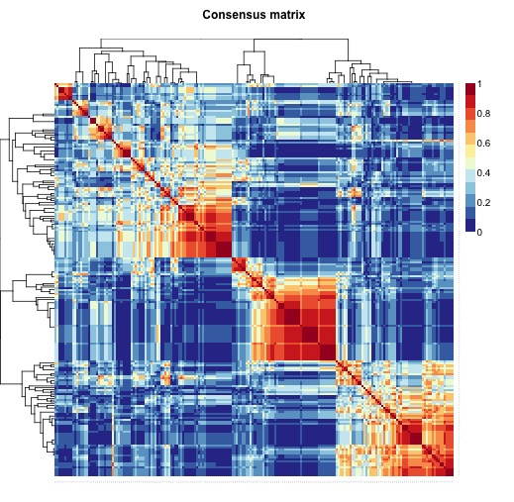
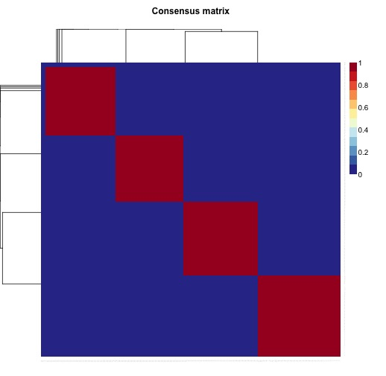
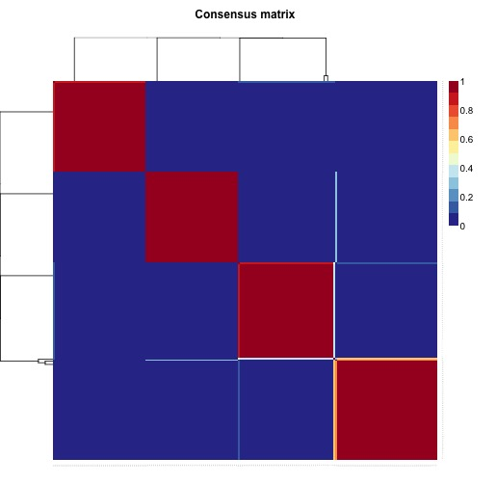
NMF+
no smoothing
gNMF+
Smoothing
(NBS)
ns-gNMF+
Smoothing

Slide 5
Objective function residual sum of square
gNMF
ns-gNMF
Graph penalty term residual
gNMF
ns-gNMF

Slide 6
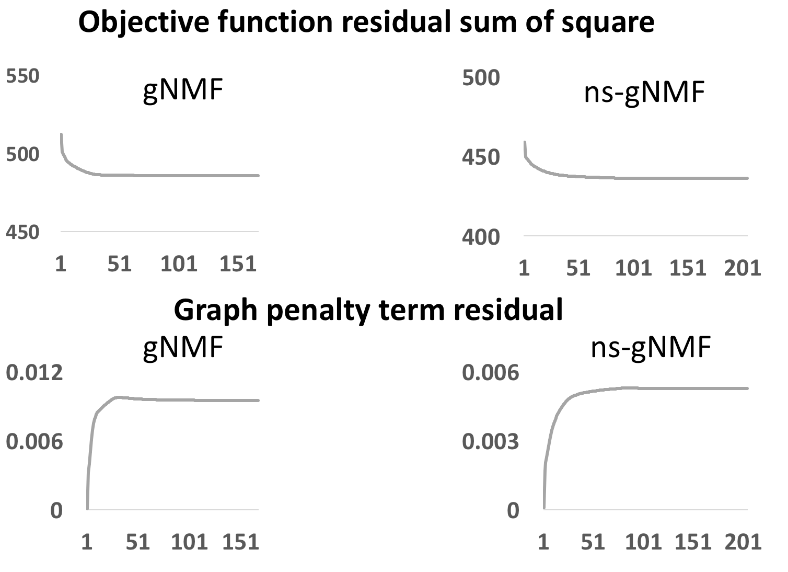
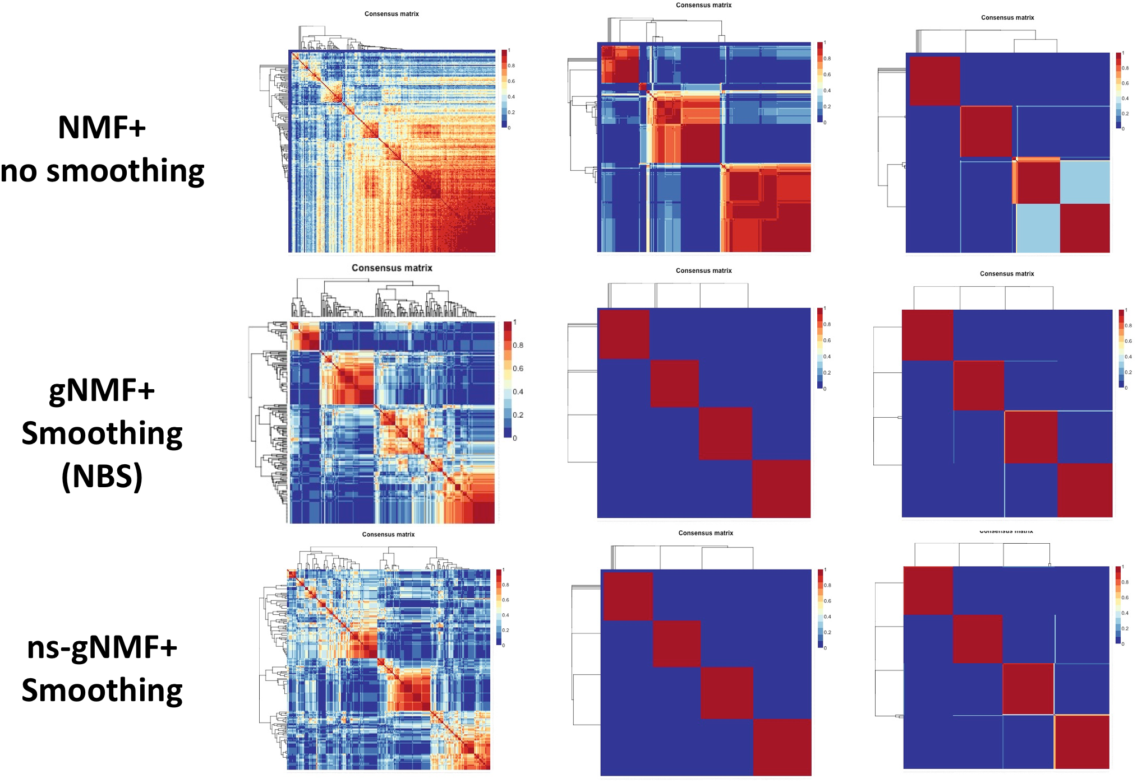
A
B
f=0.05
f=0.075
f=0.1
C

Slide 7
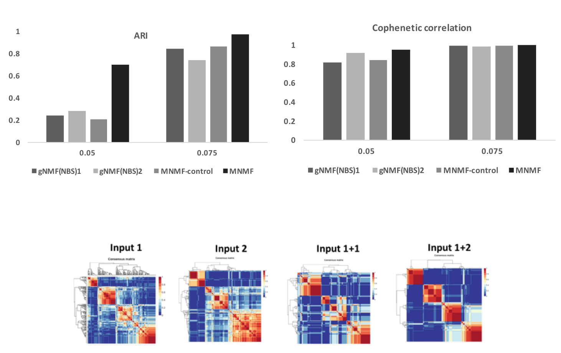
Figure 4
A
B
A
B
C

Slide 8
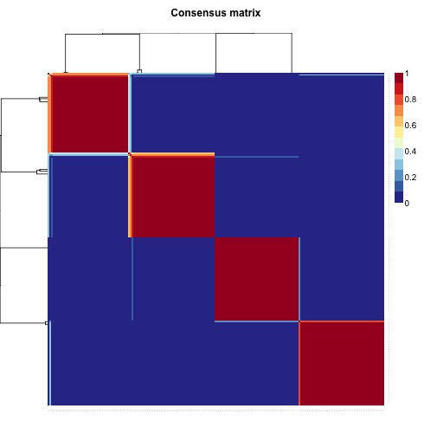
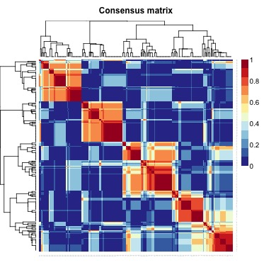
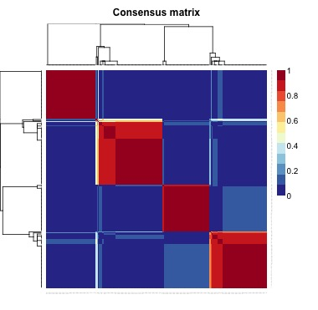
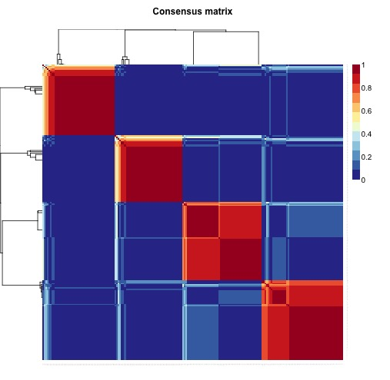
Figure 5
Input 1 shuffle
Input 2 shuffle
Input 1 +
Input 1 shuffle
Input 1 +
Input 2 shuffle
Input 1 +
Input 2 shuffle

Slide 9
Table 1
 | Input 1 | Input 2 | Input 1 + Input 2 shuffle | Input 2 + Input 1 shuffle | Input 1+ Input 1 shuffle
ARI (relative to Input 1’s underlying structure) | 0.84 | 0.74 | 0.79 | 0.00 | 0.46

Slide 10
Table 2
 | K=2 | K=3 | K=4 | K=5 | K=6
Mutation | 0.999 | 0.981 | 0.936 | 0.927 | 0.909
Expression | 1.0 | 1.0 | 0.950 | 0.971 | 0.939
Combined | 0.998 | 0.995 | 0.945 | 0.957 | 0.948
Table 3
 |  | K=3 | K=4 | K=5 | K=6
Mutation | Expression | 0.42 | 0.39 | 0.49 | 0.54
Mutation | Combined | 0.50 | 0.39 | 0.57 | 0.61
Expression | Combined | 0.63 | 0.55 | 0.58 | 0.64
Rand Index between

Slide 11
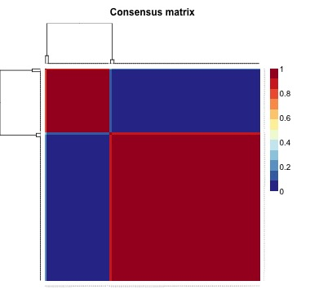
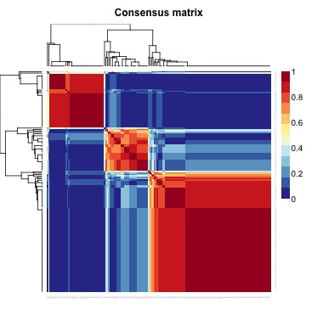
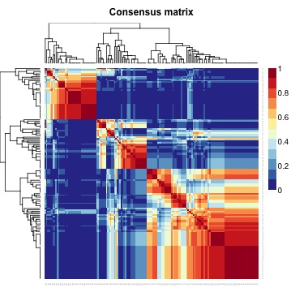
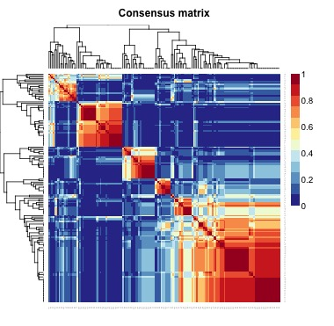
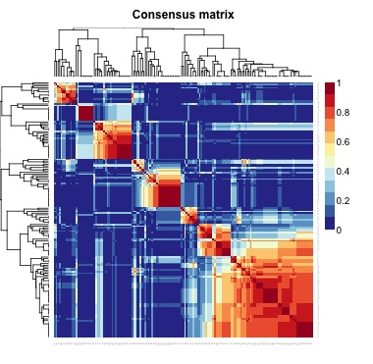
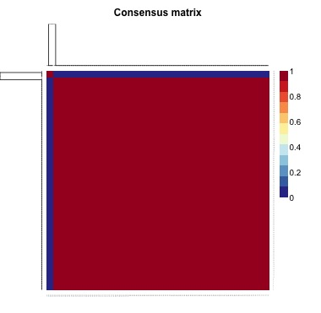
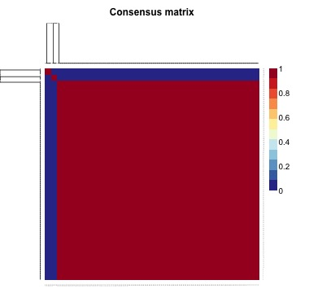
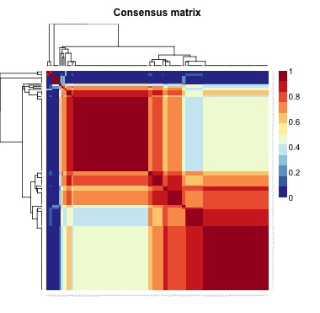
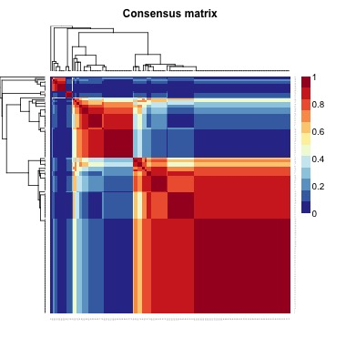
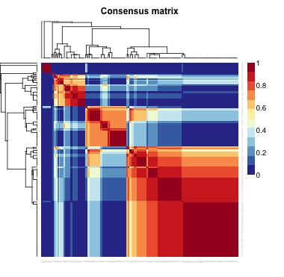
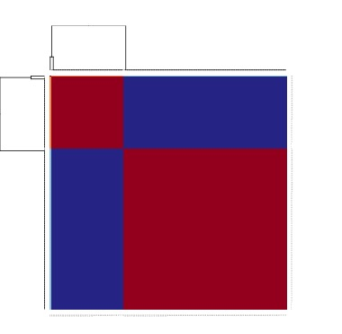
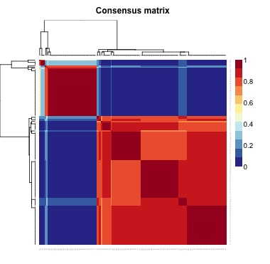
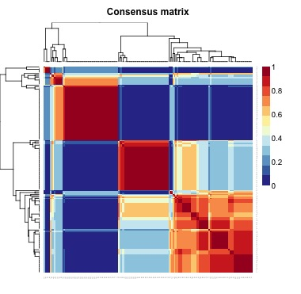
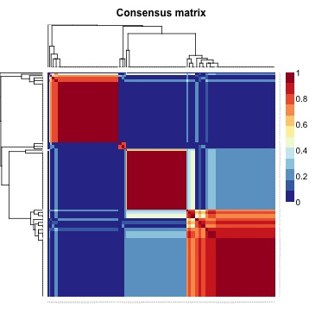
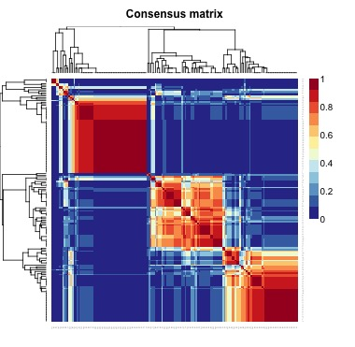
K =2
K =3
K =4
K =5
K =6
Somatic Mutation
RNA-seq
Expression
Somatic Mutation
+
RNA-seq
Expression

Slide 12
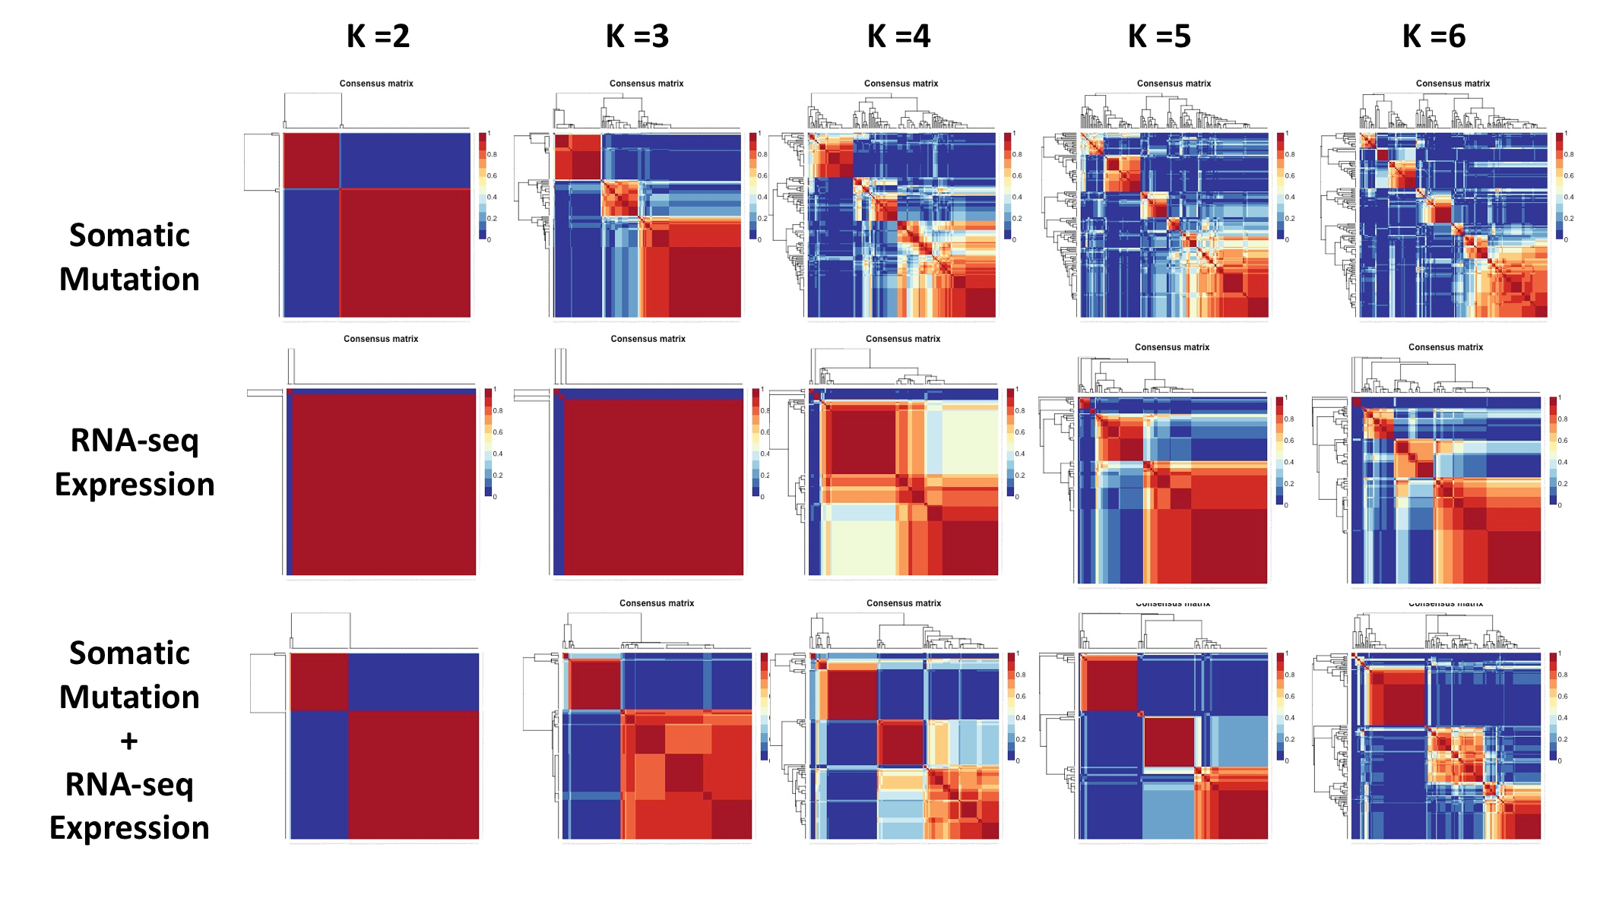
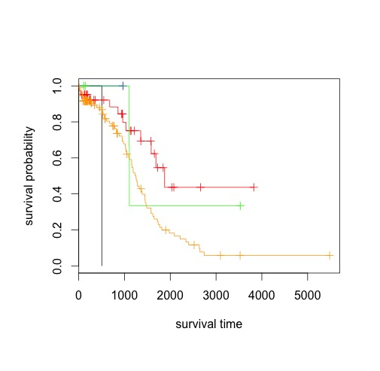
Figure 6
A
B
Log-rank test
p-value: 0.00726

